Slide 1


Quantum Counselor for Portfolio investment
Alejandro Montañez
Alberto Maldonado
Team Avocados

Slide 2

Outline
1. Quantum neural network (QNN) for stock forecasting.
2. Portfolio optimization
3. A novel approach for the Portfolio Optimization
4. Conclusion and future work

Slide 3
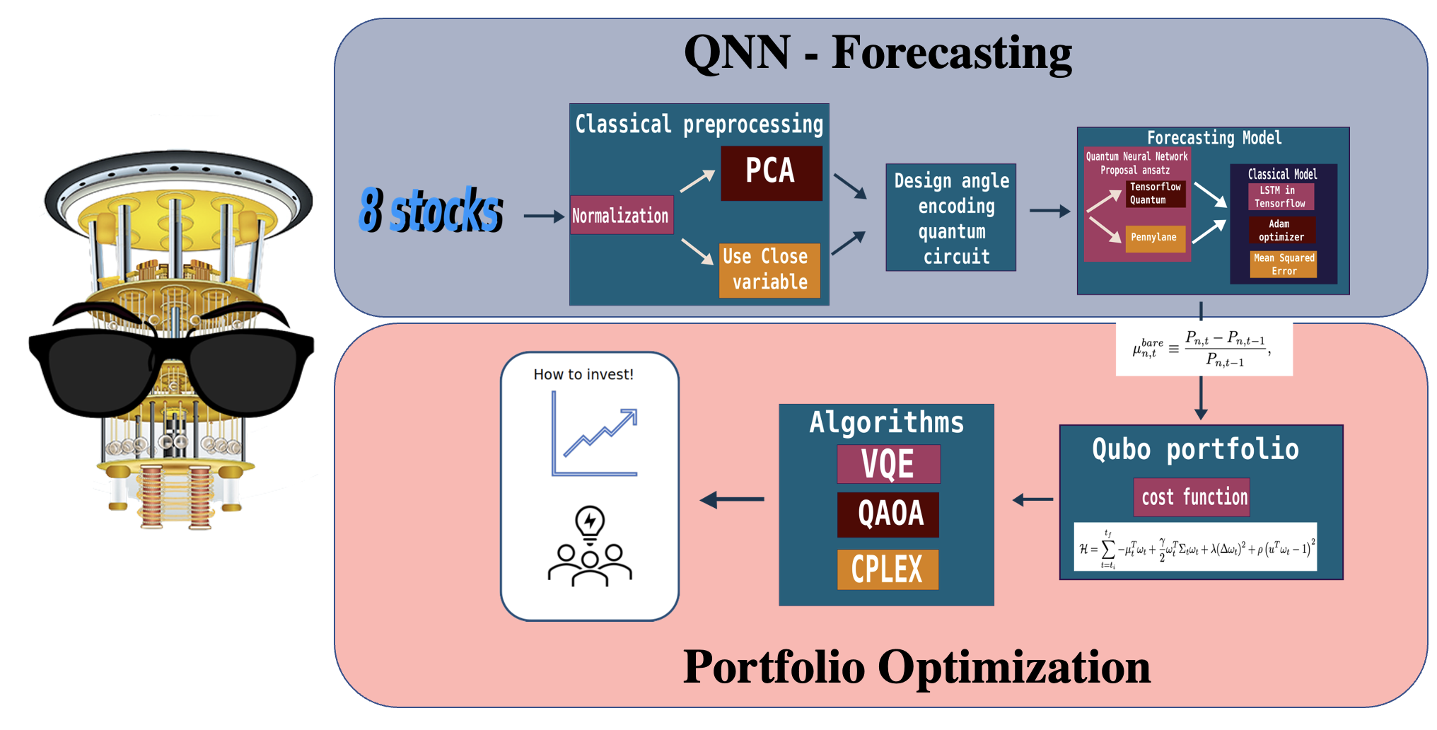

Slide 4
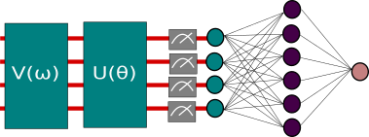
1. Stocks forecasting using a QNN

Slide 5
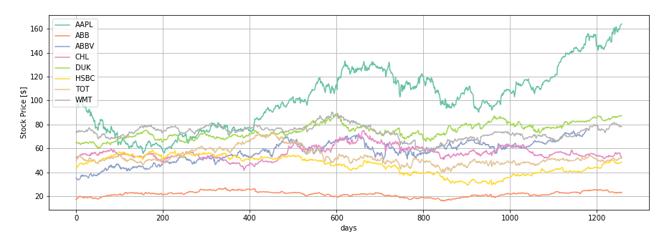
Stocks
Basic Materials: TOTAL S.A. "TOT"
Consumer Goods: Appel Inc. "AAPL"
Healthcare: AbbVie Inc. "ABBV"
Services: Wall-Mart Stores Inc. "WMT"
Utilites: Duke energy corporation "DUK"
Financial: HSBS Holding pcl "HSBC"
Industrial Goods: ABB Ltd. "ABB"
Technology: China Mobile Limited "CHL"

Slide 6
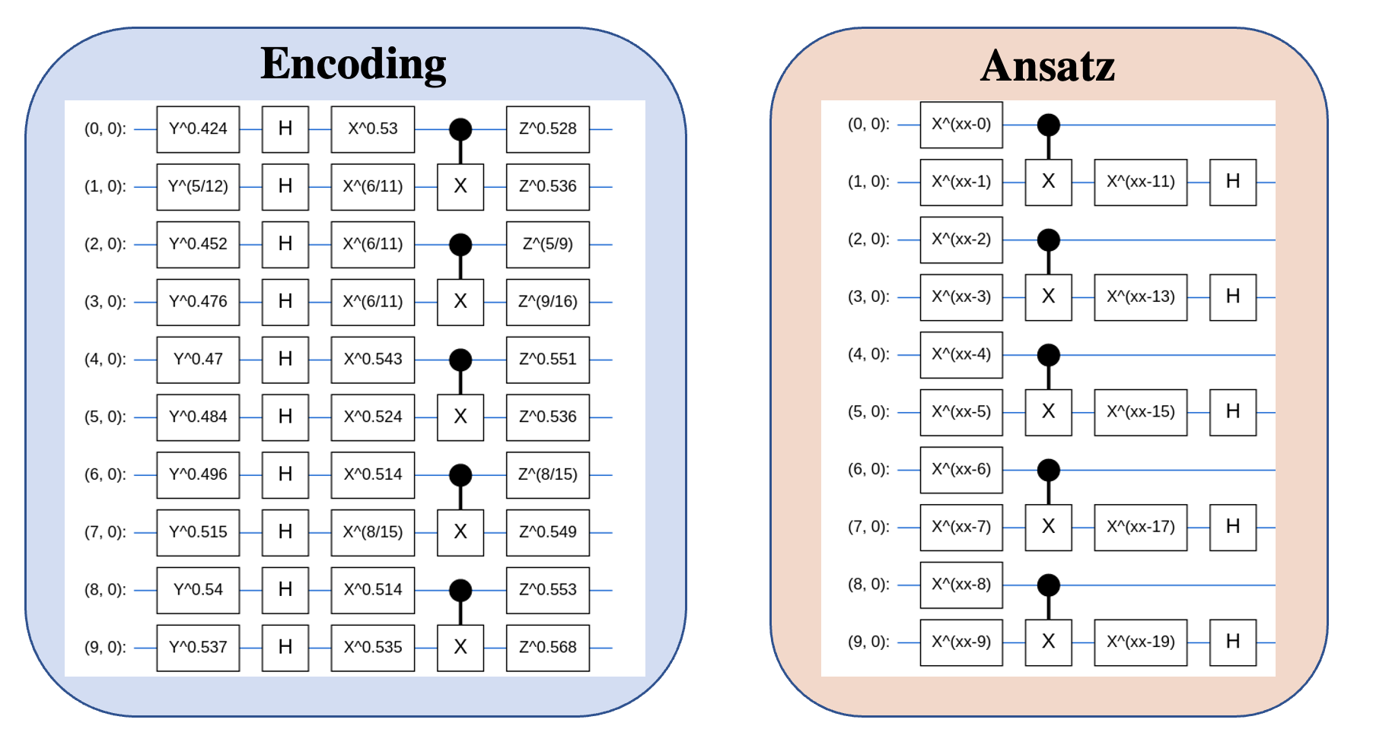

Slide 7
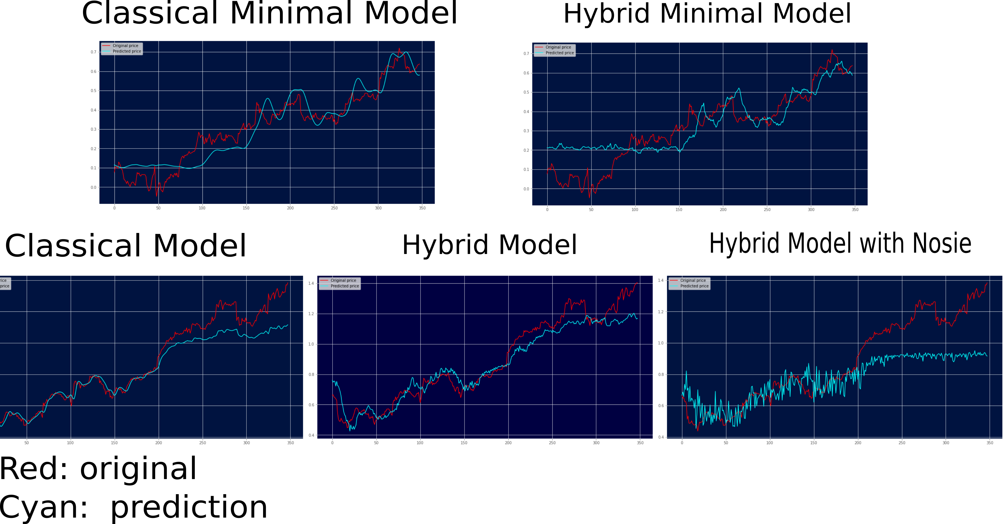

Slide 8
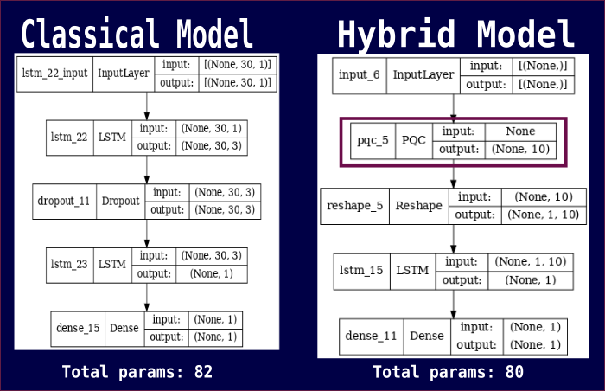

Slide 9
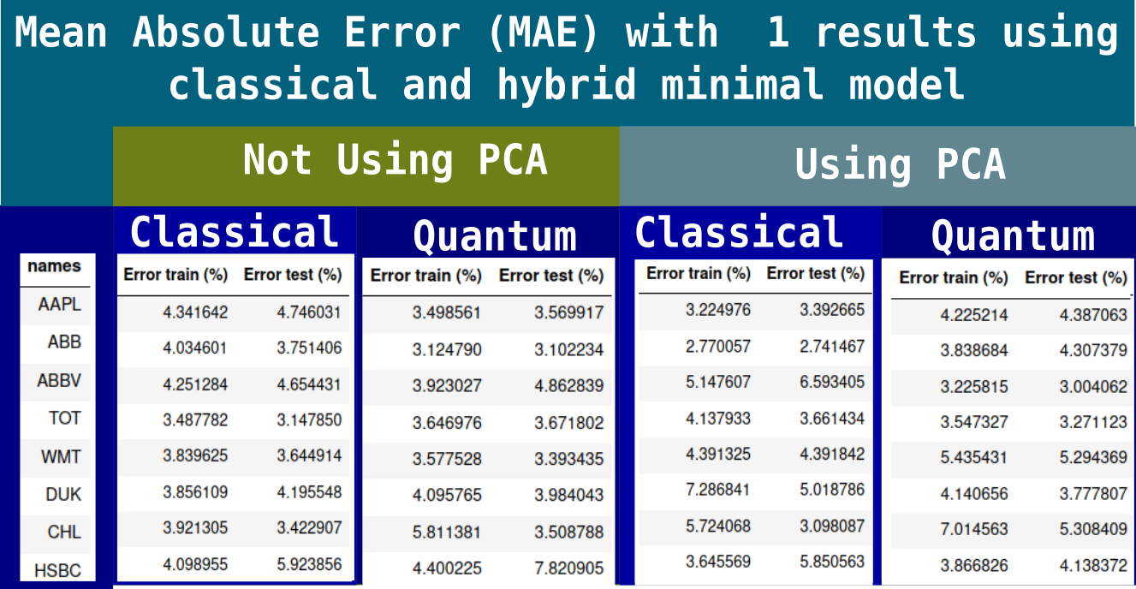

Slide 10
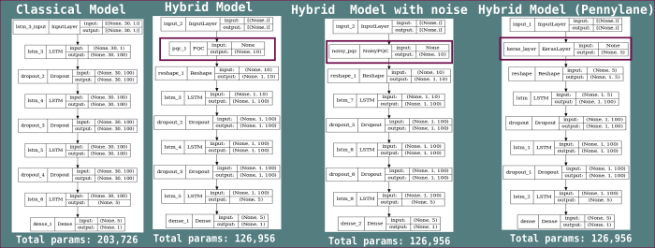

Slide 11
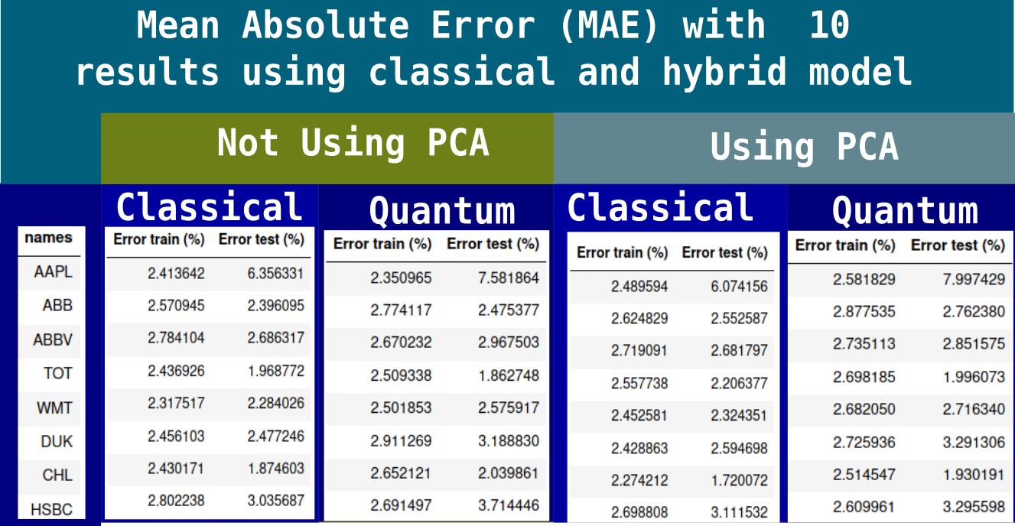

Slide 12
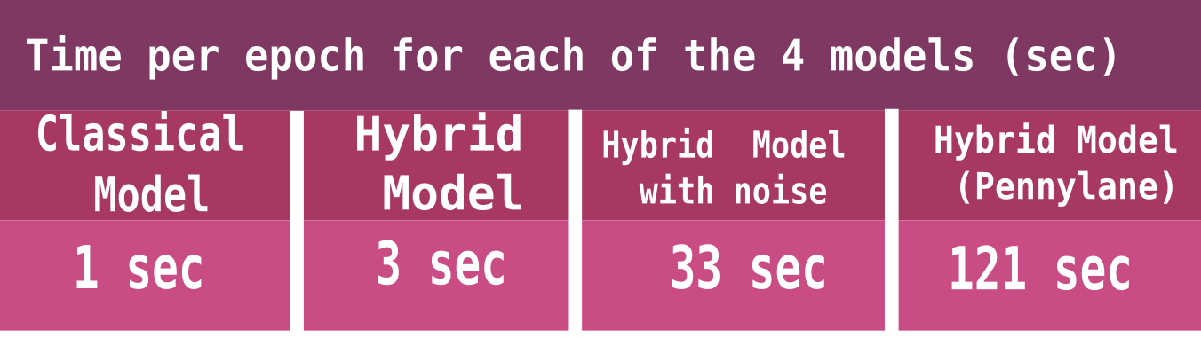

Slide 13

2. Portfolio optimization
- Model XS (3 Stocks, 2 periods), QAOA and VQE with SPSA and COBYLA classical optimizers.
- Model S (5 Stocks, 3 periods), QAOA and VQE with SPSA and COBYLA classical optimizers.
- Model M (8 Stocks, 3 periods), QAOA and VQE with SPSA and COBYLA classical optimizers.

Slide 14
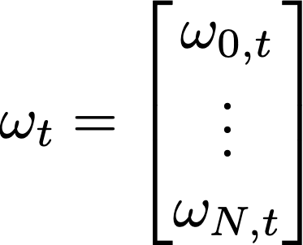
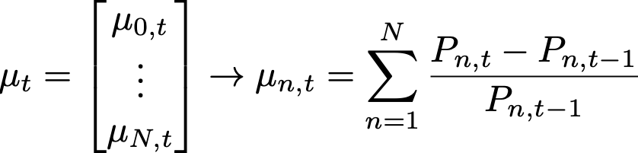
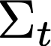
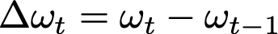
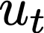
Cost Function
Transaction
Cost
Budget constraint
Return
Risk
is the covariant matrix of the returns at time t and is the risk aversion
where is the optimal parabolic coefficient of the transaction cost
is a vector with the percentage of investment for N assets at time t.
is the bare return for each asset and is the price at time t of asset n.
is a vector of ones with dimension N and is a Lagrange multiplier for the Budget constraint.

Slide 15
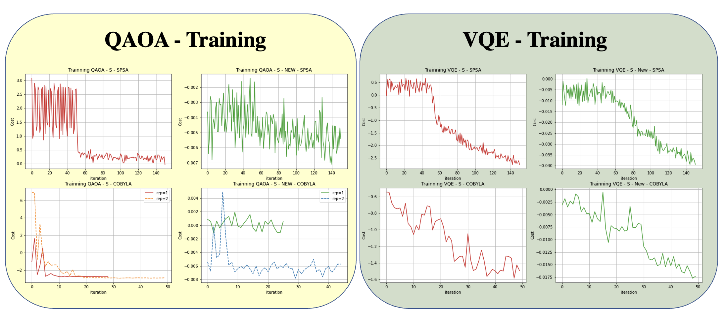

Slide 16
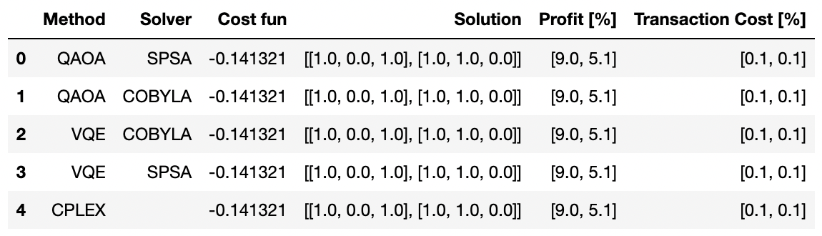
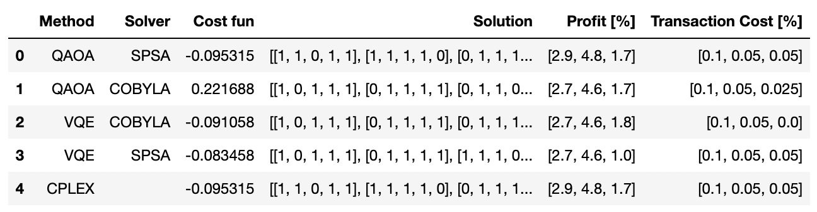
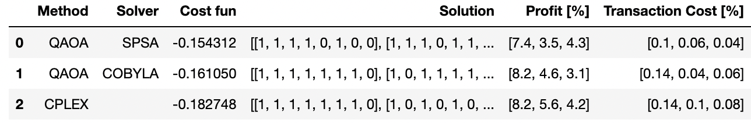
XS model - 3 Stocks – 2 Periods
S model – 5 Stocks – 3 Periods
M model – 8 Stocks – 3 Periods

Slide 17
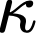
3. Our novel Approach for the cost function
Weakly Budget Constraint
Stock forecasting uncertainty
A large sum of the values would make the constraint weak while if the forecasting mean relative error is large, it will make the constraint stronger
is a vector with the mean relative error of the forecasting method for the test data and is the respective Lagrange multiplier.

Slide 18
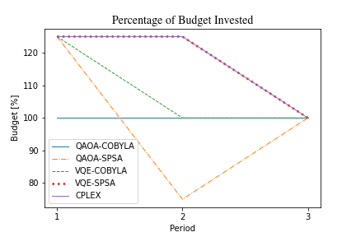
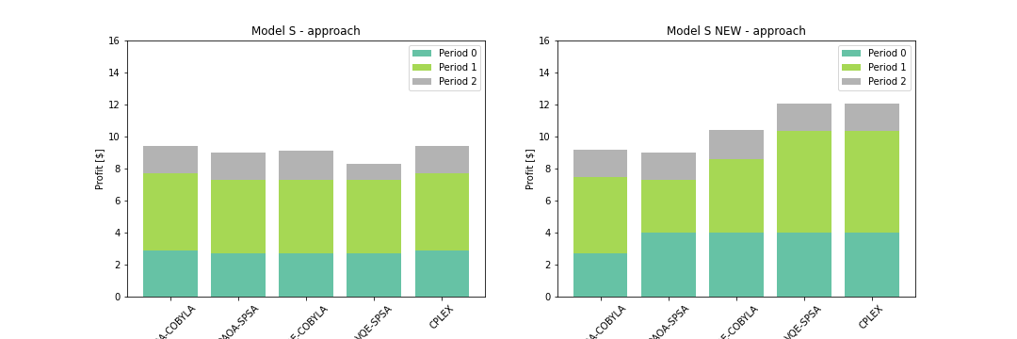

Slide 19

Conclusion and Future Work
We have come with a QNN model capable of forecasting the price trend for different assets. This model present some advantages when compare with classical approaches.
We implement satisfactorily the problem of optimization portfolio using qiskit with two quantum solvers QAOA and VQE, and we compare the results with a classical solver CPLEX. Even though we select a small number of maximal iterations, the quantum models come to the optimal solution.
We implement a new approach for the objective function called the budget increment opportunity, where if there is a great opportunity of investment (high bare return and low uncertainty in the forecasting) the budget constraint becomes weak. This approach allows us to get a considerably increment in profits.
For next work, we want to implement these methods on a real hardware. Unfortunately, we couldn’t make it because some technical difficulties with the two backends where we tried it. Additionally, we want to add fundamental analysis as input to the QNN, to explore new ways of improving the forecasting ability.

